Slide 1
UAV-based LiDAR Data Processing User’s Guide
Smart Water Systems Laboratory
University of Saskatchewan, Centre for Hydrology
2022

Slide 2
Three Main Steps
GPS base station data processing
Generating trajectories of LiDAR flights
LiDAR data processing
Image data processing
RAW Images:
DCSxxxxx.jpg
Image Processing:
Camera Data Wizard/Color Scan Wizard
Timestamped Images:
DCSxxxxx.jpg
2

Slide 3
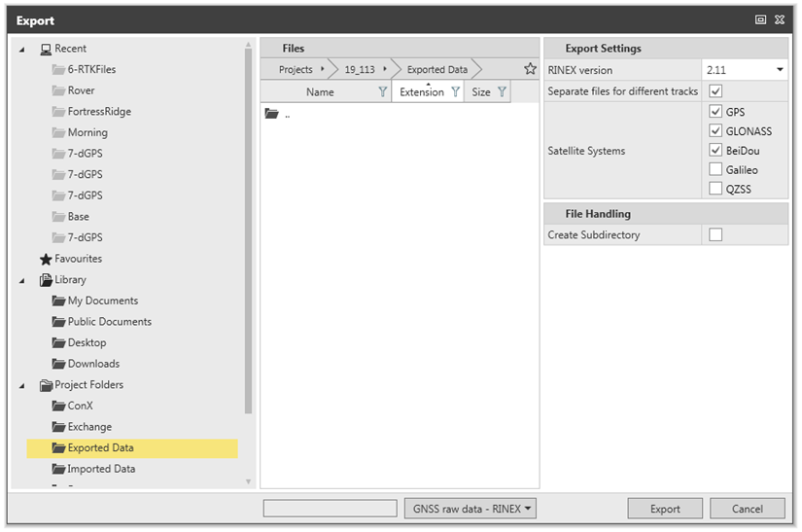
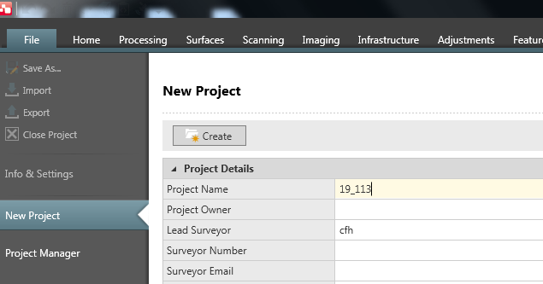
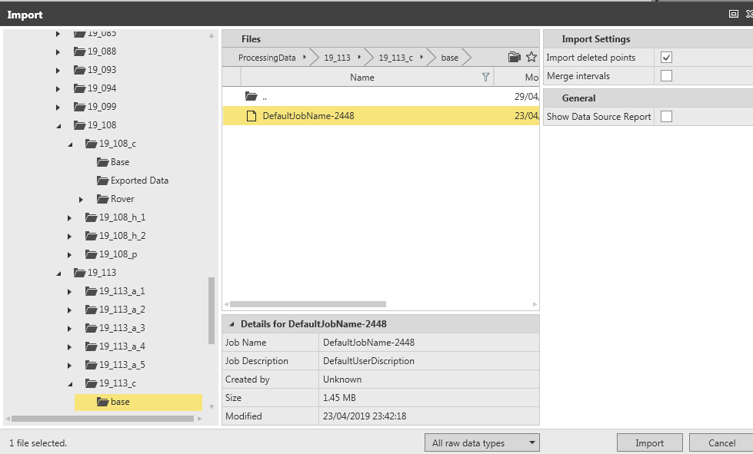
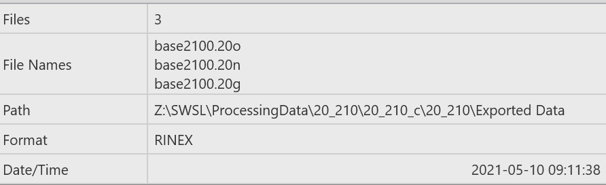
GPS base station data processing
Tools: Leica Infinity; CSRS-PPP
Step 1: Create a new project (yr_JulianDay)
Save to yr_JulianDay_c\ new folder\
Step 3: Export results in RINEX format
Step 2: import *.m00 file (base station data)
Find the rinex results in the folder
Step 4: GNSS tab > click base > Nav RTK pt to > Control point > change coordinates to match BASE PPP PDF
*Make sure antenna height matches the PPP pdf

Slide 4
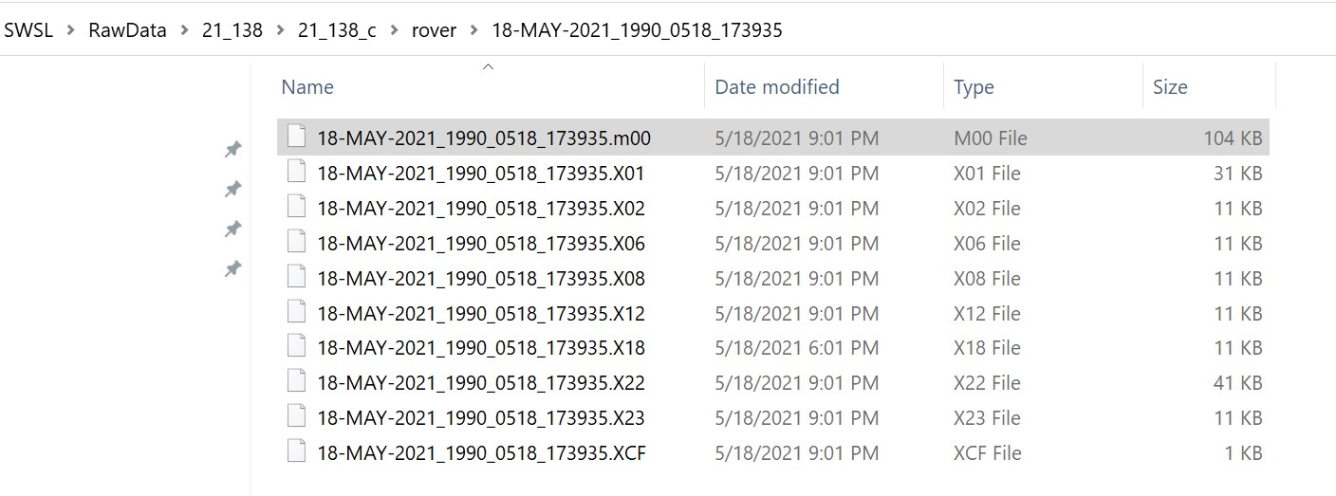
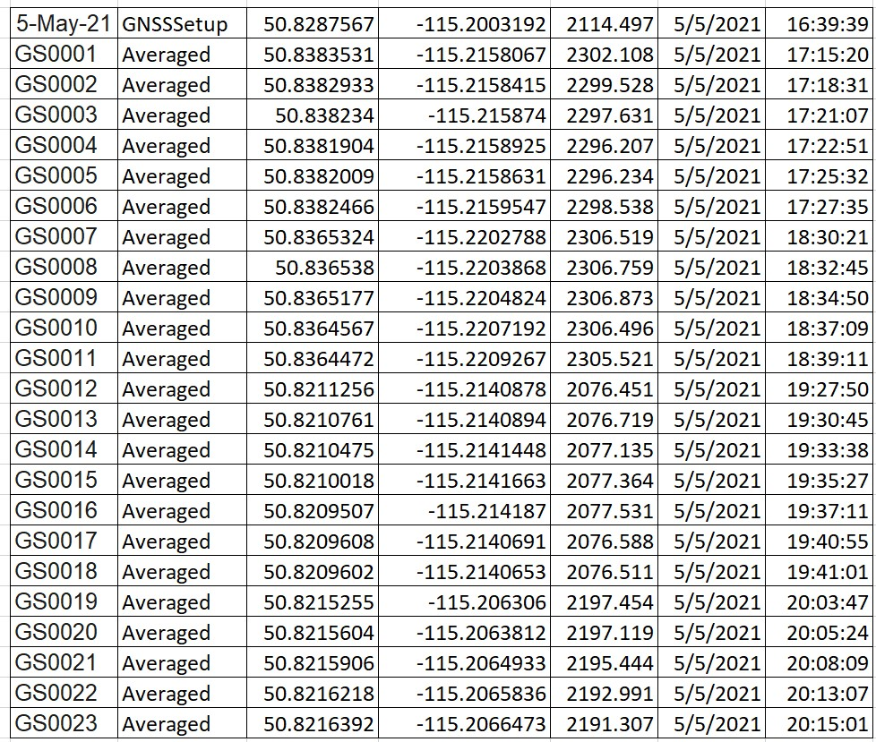
GPS ROVER data processing
Tools: Leica Infinity; CSRS-PPP
After exporting the RINEX file:
1. Import the *.moo file from the ROVER folder.
2. Export the file to text or to Ascii
3

Slide 5
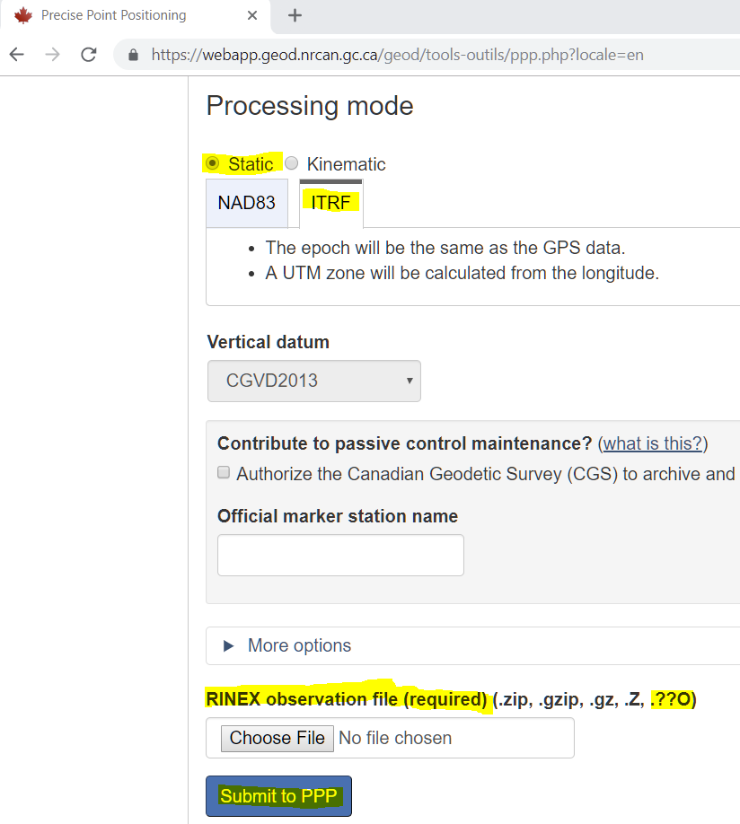
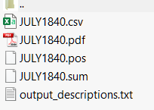
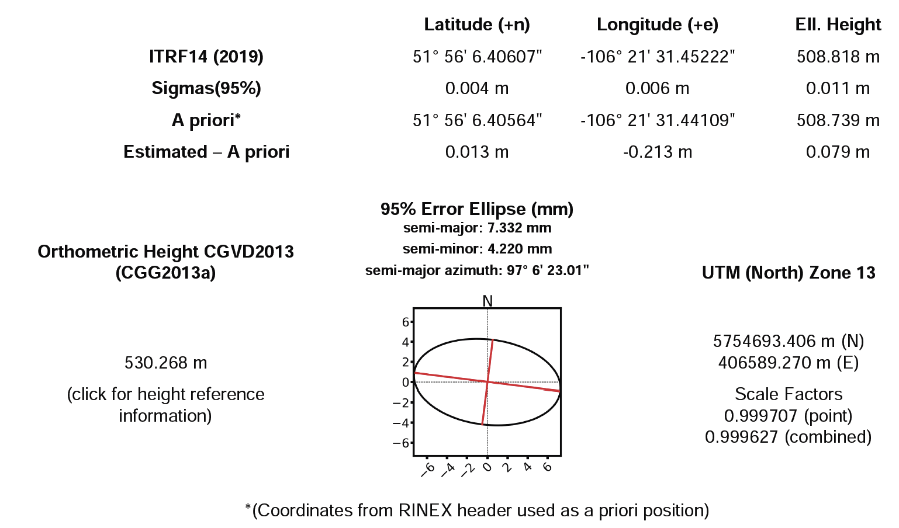
GPS base station data processing
Step 4: CSRS-PPP results (login required)
full-output.zip will be sent to the email address, which is used to login at CSRS-PPP, after submitting the *.**o file.
Unzipping full-output.zip provides the following files
For Rover / eMotion data processing
For Pospac Projection Definition
5

Slide 6
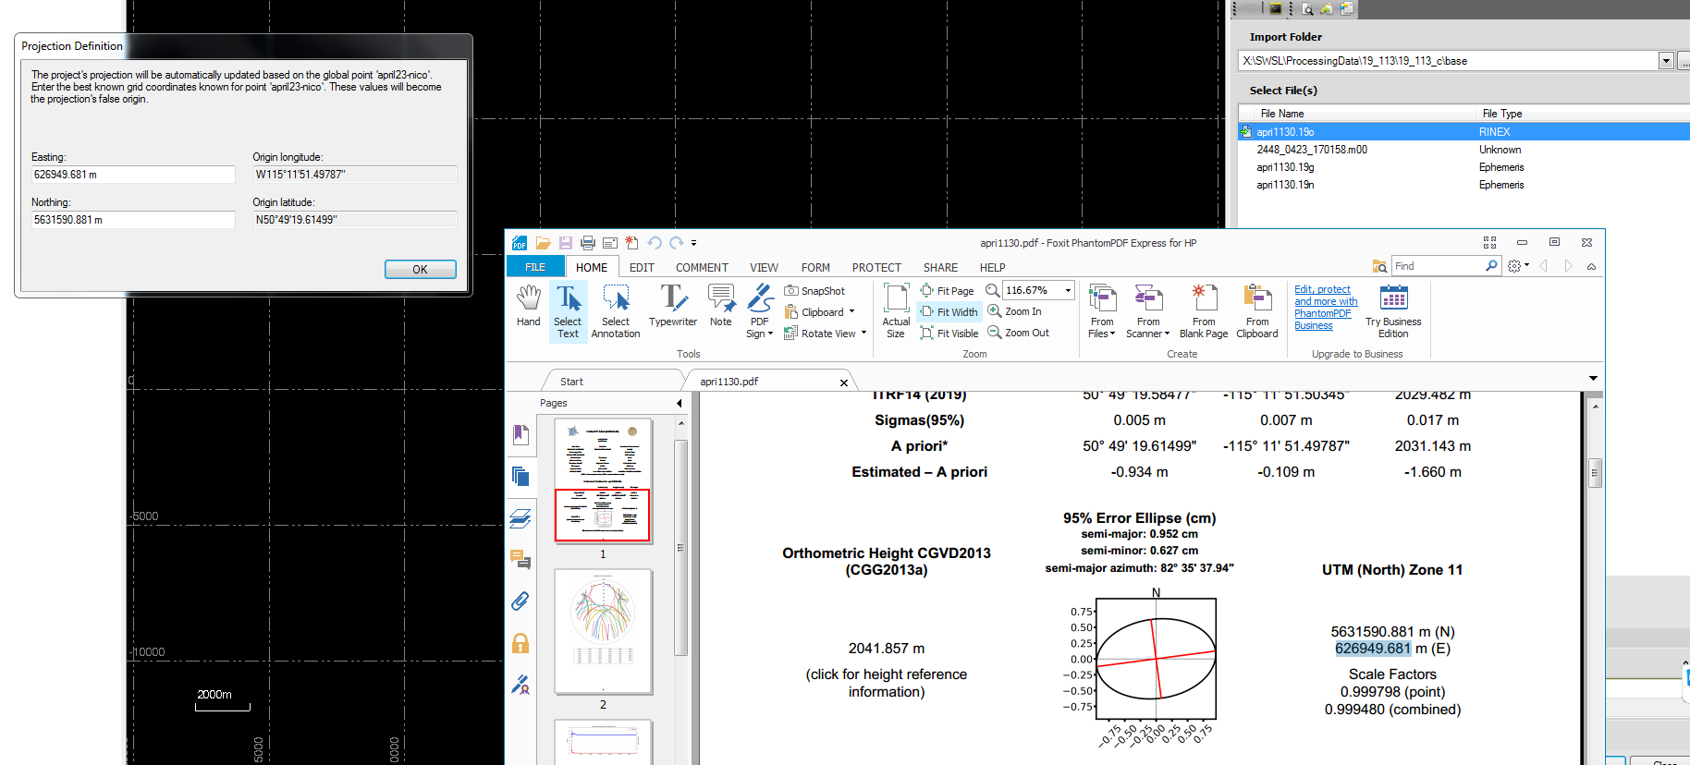
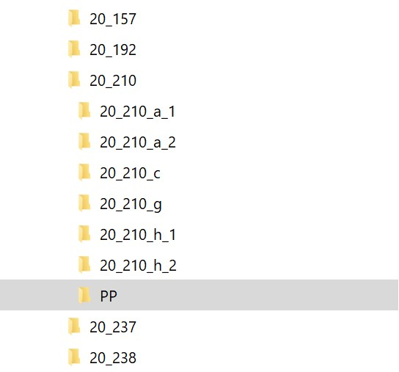
Generating trajectories of LiDAR flights
Tools : POSPAC UAV Software
Step 1: Create a new default project and provide name;
Double click “Mission1” to rename and “Save As” for the project location. Make Directory under main Processing directory. (within your proj__a folder)
Step2: Import Rinex observations: *.**o file from the “exported data” folder
Step 3: Projection Definition
* This PPPs our IMU data for the drone
* go to base station > coordinate maniger to update coord to PPP coord, check attn height again
6

Slide 7
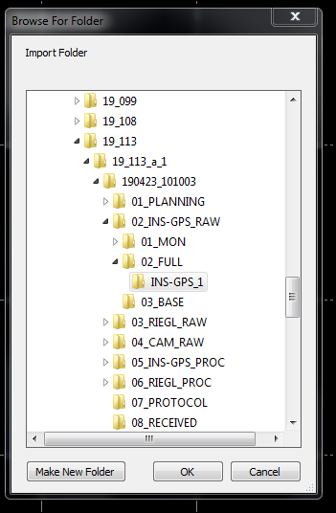
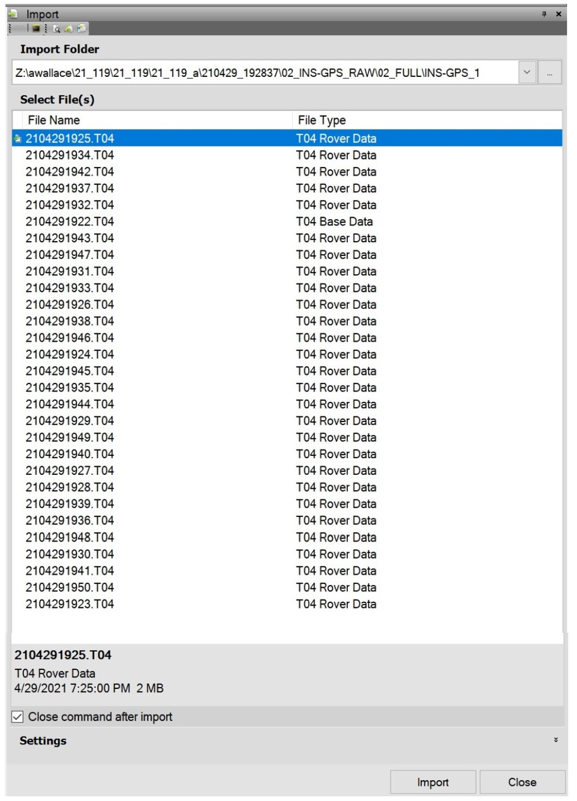
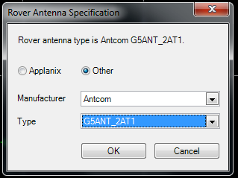
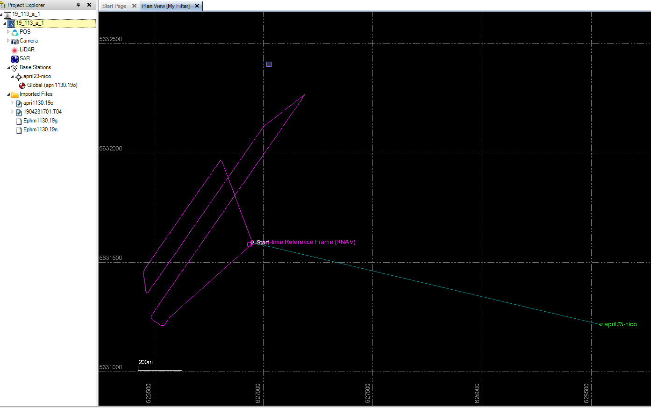
Generating trajectories of LiDAR flights
Rover Antenna Specification
Choose ‘Antcom’ and ‘G5ANT_2AT1’ for MINI-VUX1 DJI-M600 ONLY
Choose ‘Applanix’ and ‘AV14’ for MINI-VUX2 ALTA X
Step 4: Import *.T04 files from the folder below.
If “T04 Rover Data Extraction”window does not appear –check T04 file sizes or missing files
Successfully imported T04 files
Import T04 files from (__a folder > ins folder)
T04 rover data extraction
IMU continuity check
Data Preview/Ephemeris check (only got checks on GPS and GLONASS)
Broadcast/Precise Ephem/download
WAIT for Checkmarks !! ✓
Downloads – Just Wait!!
Antenna Selection
Trajectory now shows in window
Check .T04 files. Last (and first) file could be smaller. Check sequence, If missing files check storage on drone
7

Slide 8
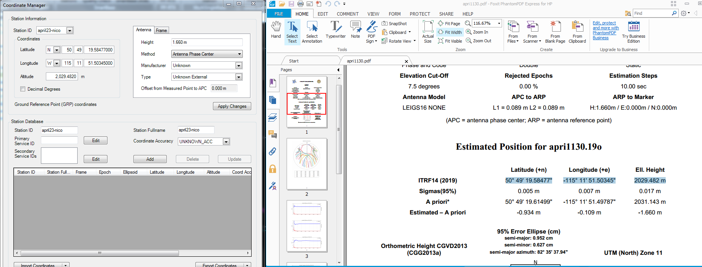
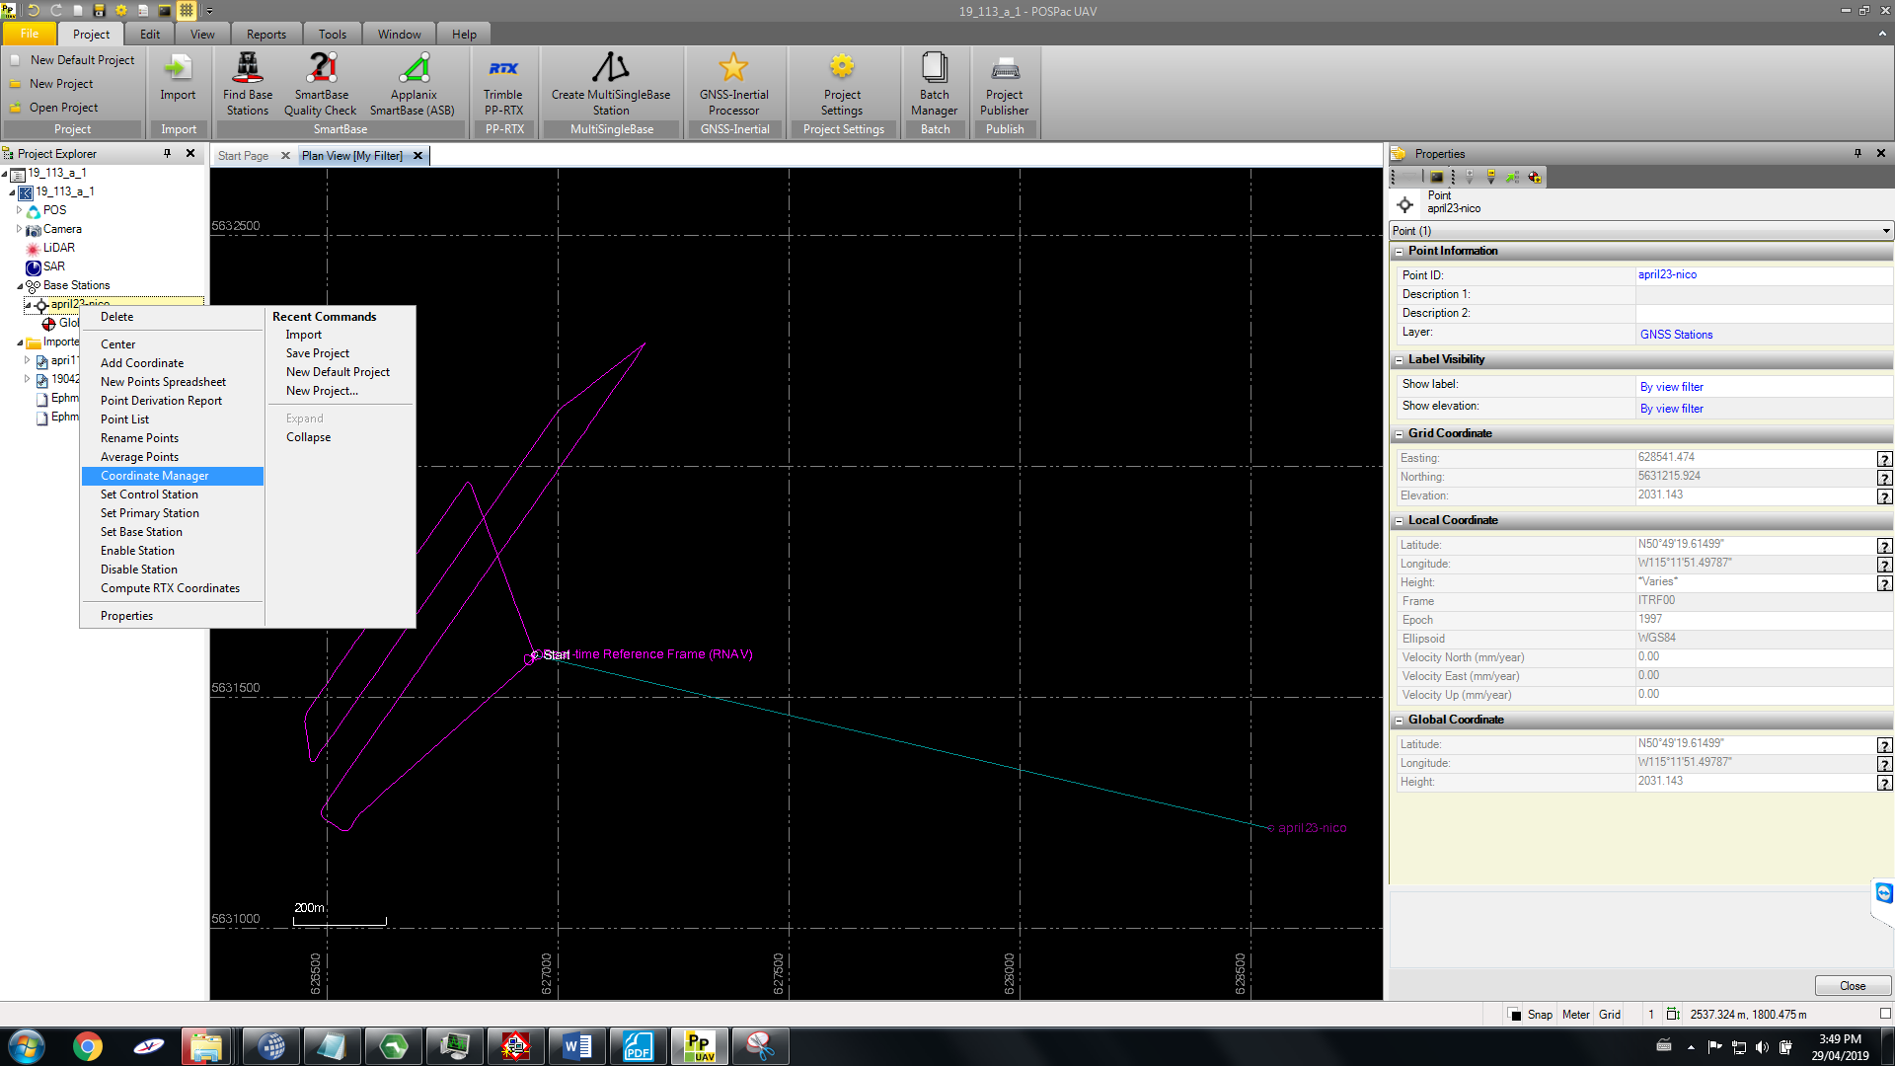
Generating trajectories of LiDAR flights
Step 5: Coordinate Manager
using CSRS-PPP Results
Important to Apply Changes
<number>

Slide 9
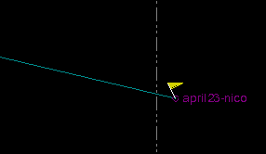
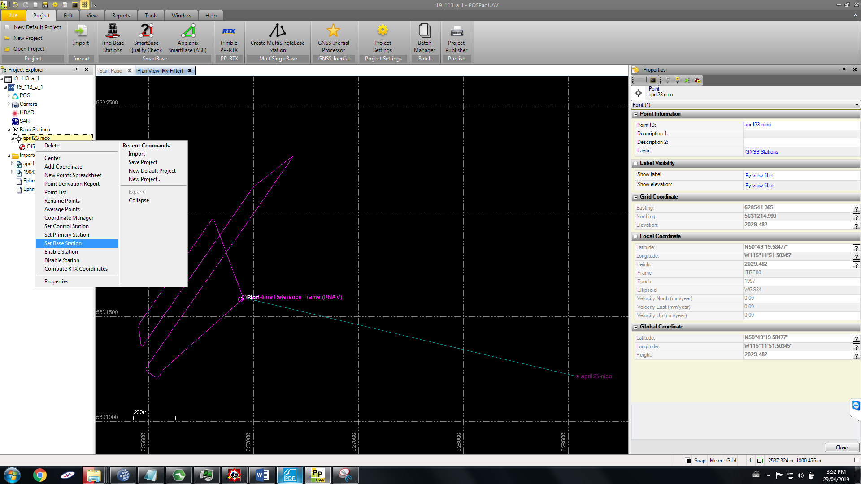
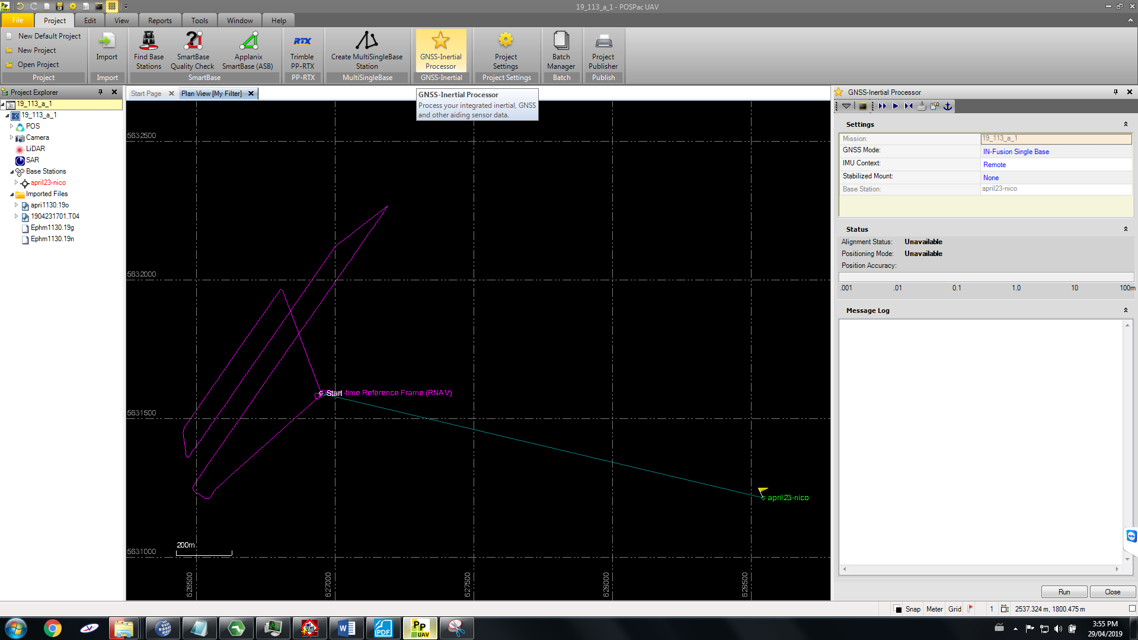
Generating trajectories of LiDAR flights
A flag at the base station will show up after data is processed.
Step 6: Set Base Station
Step 7: GNSS Processing
“OK” for GNSS QC Stats
Takes time to start and finish. Check mostly fixed solution
<number>
Step 7: Need to update drove anntenna offset from lidar window
- Project settings >
- x = 0.553 m
- y = 0.068
- Z = -0.342
St Dev = 0.03 m
Repeat all this for each flight folder or figure out batch processing from allister

Slide 10
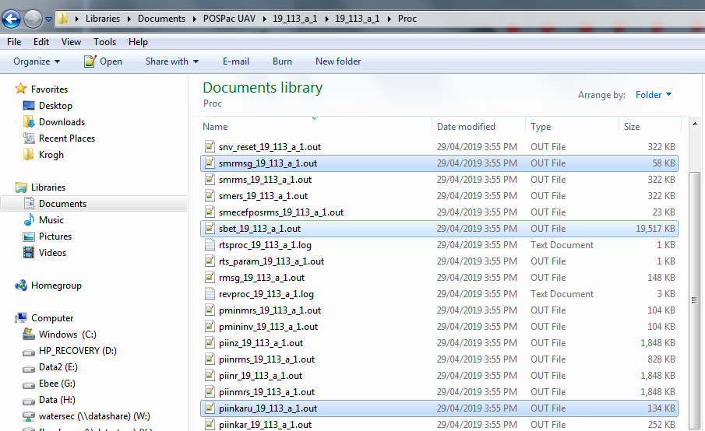
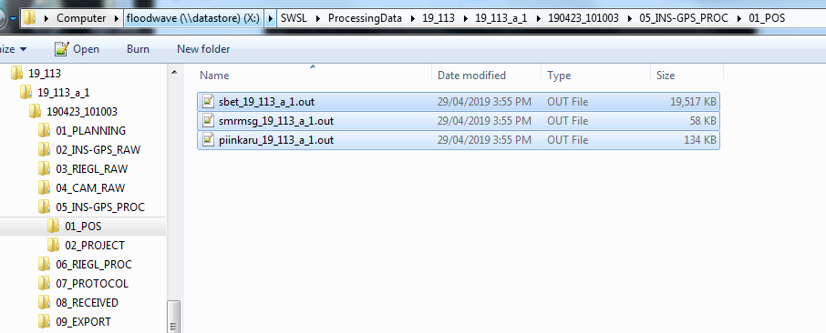
Generating trajectories of LiDAR flights
Step 7 con’t: GNSS Processing
Find the three files in the POSPAC project folder.
sbet***.out, smrmsg***.out, piinkaru***.out
Copy into the corresponding project LiDAR data folder
<number>

Slide 11
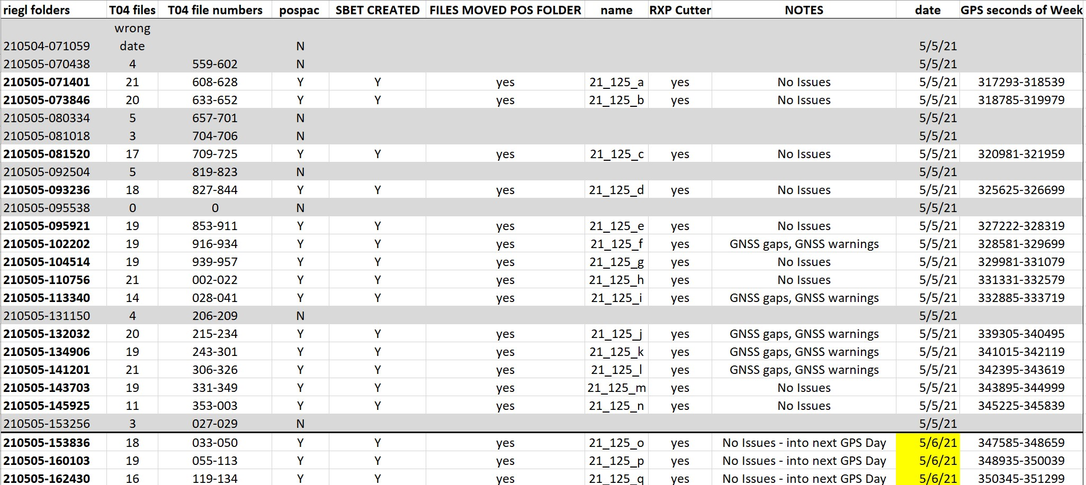
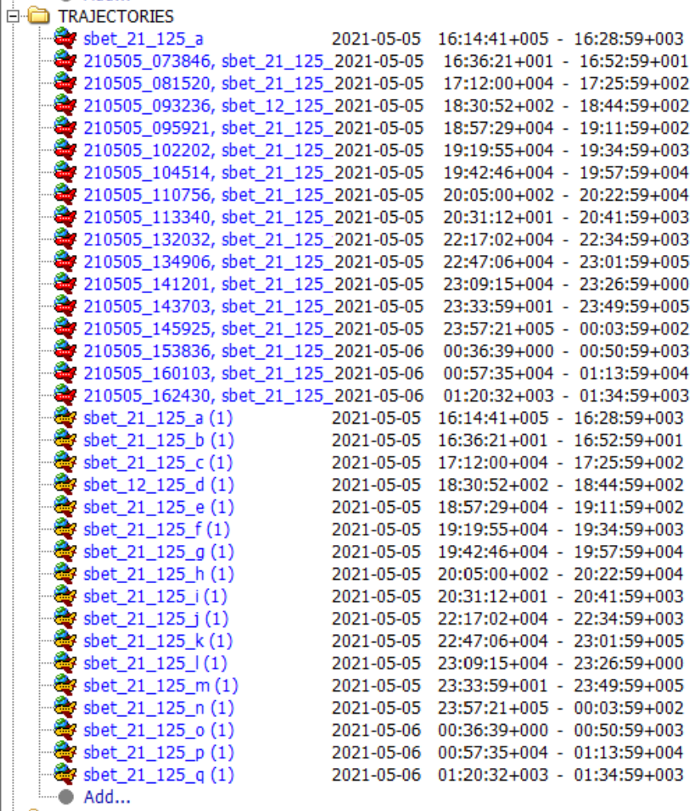
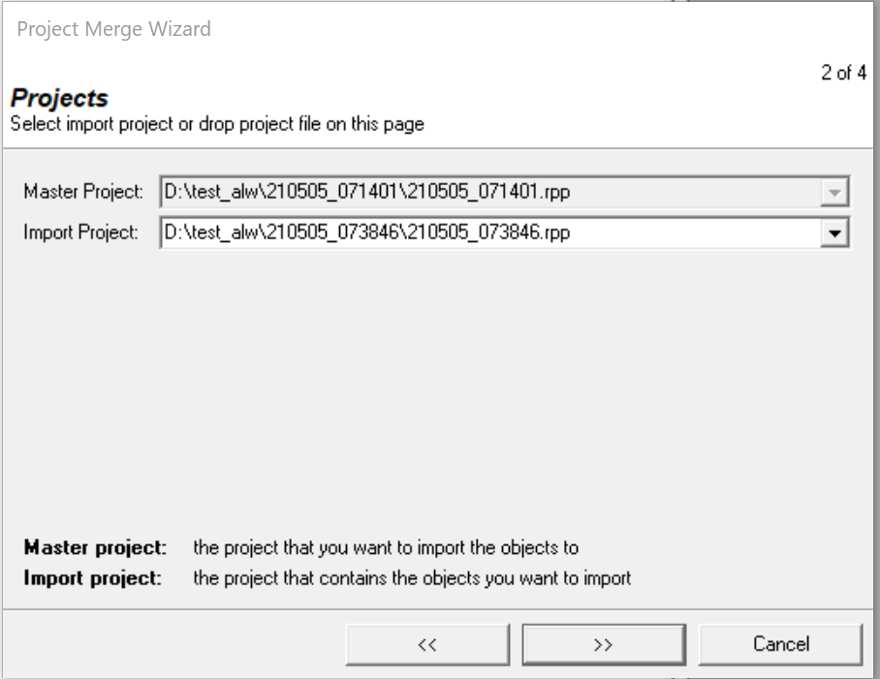
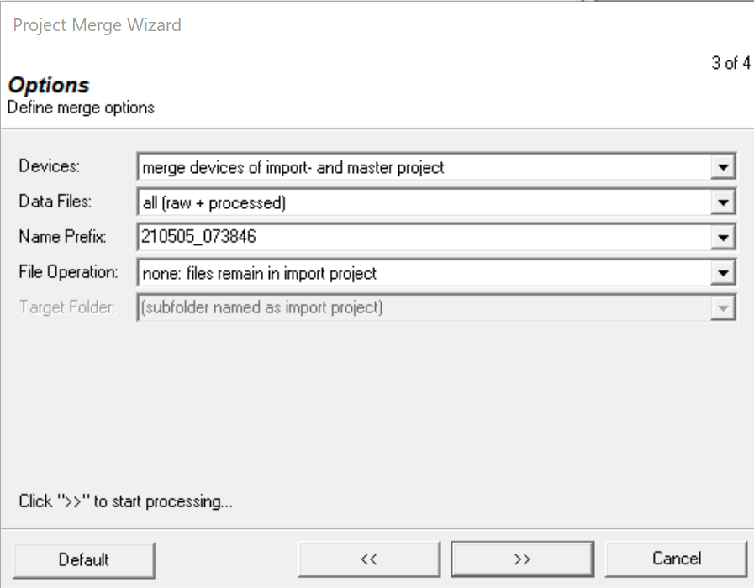
Multi-Flight Processing (eg: Fortress Mtn)
Determine which projects need to be included: remove folders with < 5 T04 files
Process base station (leica) and trajectory (applanix) for each remaining project.
Complete RXP Cutter on each trajectory in its respective project
Remove all Records_001 and save each project
Choose a Master project and one by one merge all other projects into the Master with Merge Wizard.
Now continue with Step 5: Data Processing Wizard, Step 6: RiPrecision, Step 7: Export
Riprocess will not determine correct date in POF Import (step3 lidar processing)
<number>

Slide 12
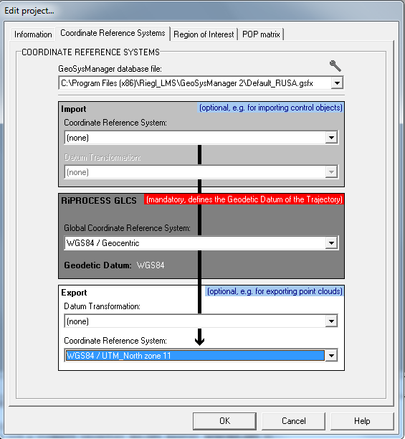
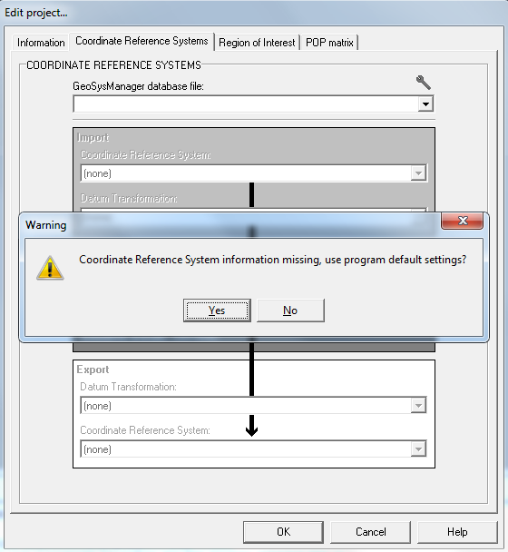
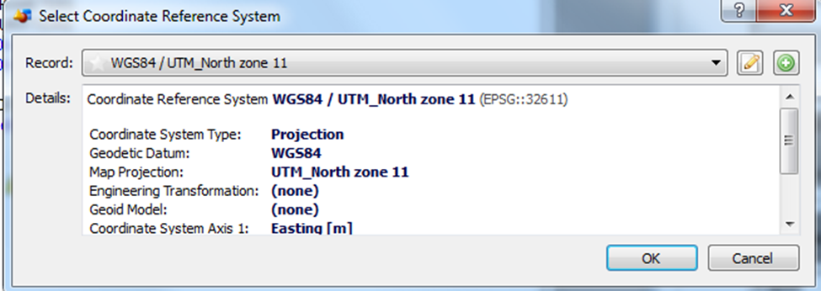
LiDAR data processing
Tools: RiProcess
Step 1: open a project file ‘*.rpp’ from the lidar data folder named ‘*’;
Step 2: The project coordinate reference system;
If Coordinate Reference System has no dropdown menu. It is the same across projects / provinces New GeoSysManager database file: NewDatabase.gsfx
Choose correct zone
Alberta = zone 11
Saskatchewan = zone 13
OK to proceed
Project coordinate reference needs to be added.
Choose yes; Then select the coordinate reference system at “Export” part of this window.
<number>

Slide 13
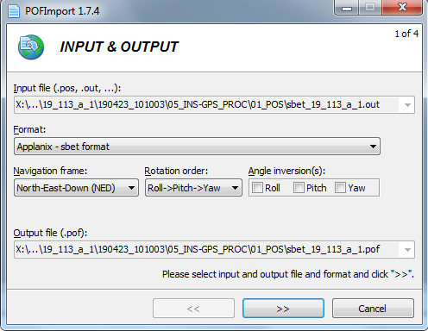
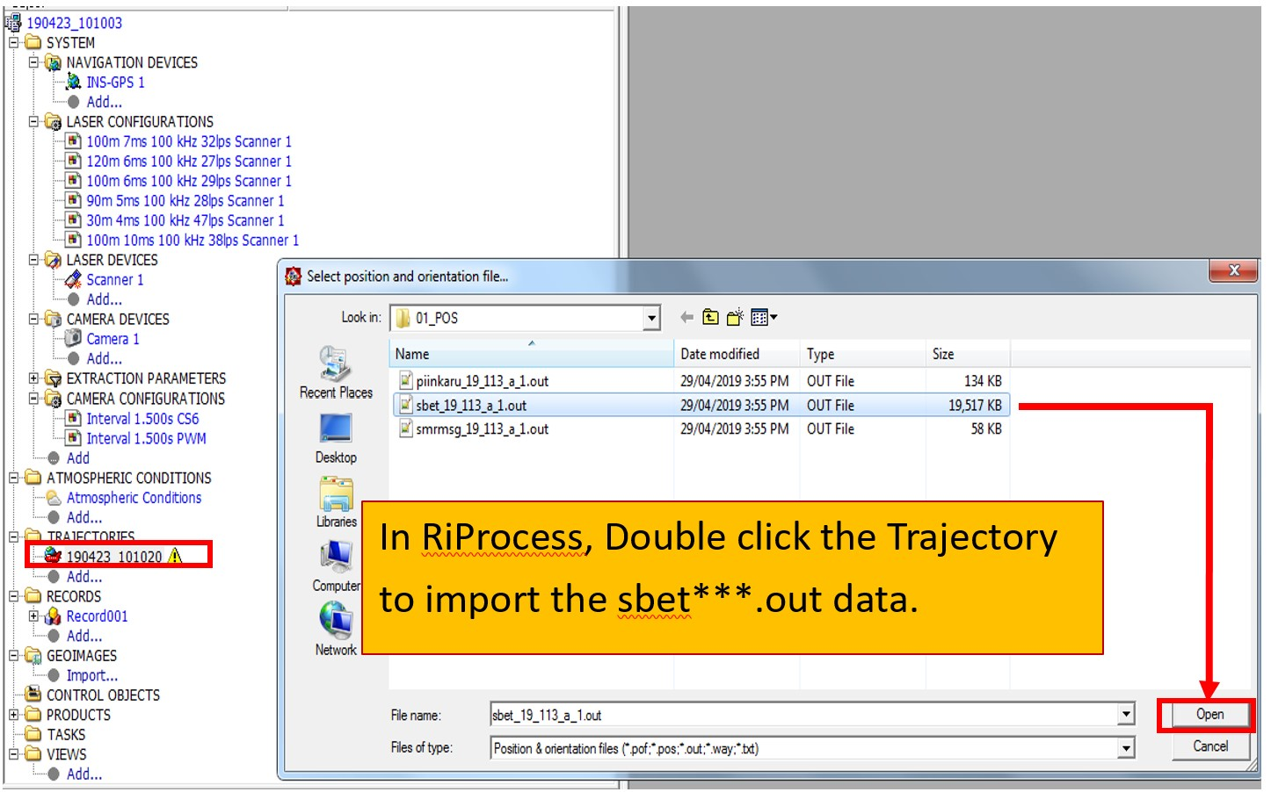
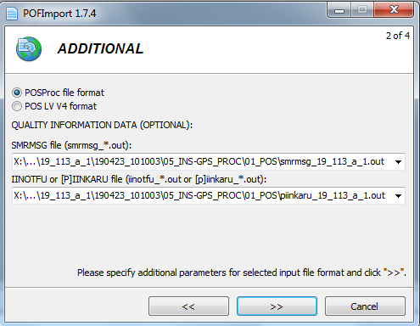
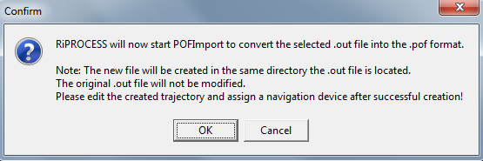
LiDAR data processing
Step 3: Importing trajectories
<number>

Slide 14
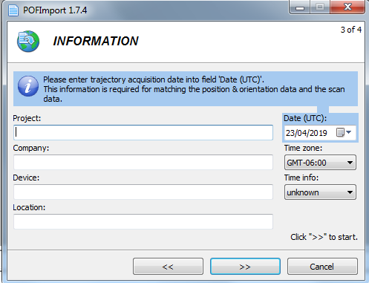
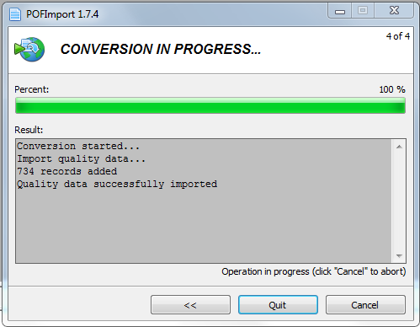
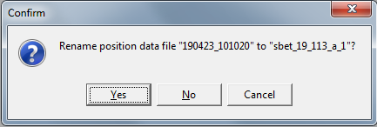
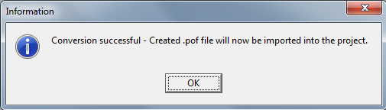
LiDAR data processing
Step 3: Import calculated trajectories of this project;
Determine UTC time of the flight. If over midnight then dates will change in middle for processing for long flights (fortress)
GPS week Seconds
Day 1 – 86,400
Day2 – 172,800
Day3 – 259,200
Day4 – 345,600
Day5 – 432,000
Day6 – 518,000
Day7 – 604,800
IF POSPAC BATCH processing was used for SBETS choose NO to give unique name to SBET.
**All SBETS from PP BATCH processing are named SBET_mission1**
<number>

Slide 15
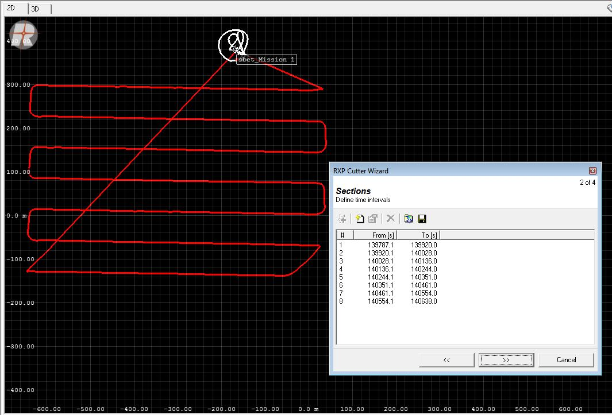
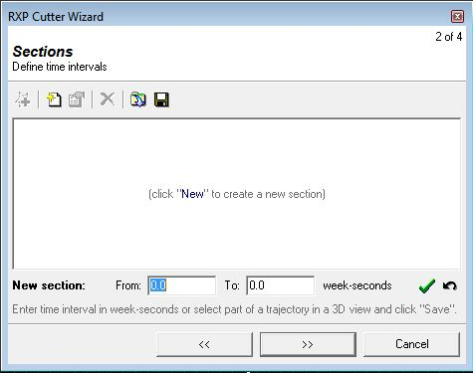
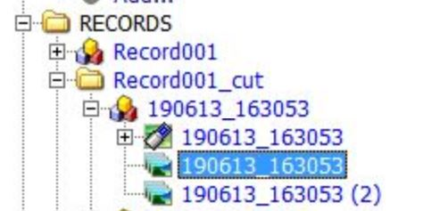
LiDAR data processing
Step 4: Trajectory Preparation
Highlight the Trajectory in left window list. Choose RXP Cutter from the Tools Menu Check the checkbox (create new traj) <next> (the traj will appear) Choose “new” from the next window (start and end time windows appear) Start and end times need to be added for each line of data Determine the start / end time for first line by placing polygon on traj. Note the start time….place another polygon over the end of the line. White is GAP and will not be included - | Replace the start time from the beginning of the line and choose the GREEN checkmark. This will enter the start and finish of the first trajectory. Choose NEW icon (circled orange) New blank time windows appear. Repeat until ALL line are done. Make sure the lines are in order of time or it will not process. Choose <next> highlight the laser data file associated with traj and choose <OK>. Processing progress shown in “TASKS and SERVERS”
New Wizard Selection Option:
- automatic trajectory selection
- POI: entire traj
- Min Turn Angle: 60
- Max Course Deviation: 30
- Min Segment length:
- Min Relative Speed:
.csv file
From[s] | To[s]
139787.1 | 139920.0
139920.1 | 140028.0
140028.1 | 140136.0
140136.1 | 140244.0
140244.1 | 140351.0
140351.1 | 140461.0
140461.1 | 140554.0
140554.1 | 140638.0
NOTES: All start times end in .1 and all end times .0
Once all lines are input save to a .CSV file.
New “Records00X_CUT” will appear After RXP cutter is finished.
**REMOVE all other Records entries before data processing** this is from the records drop down, doesn’t delete anything just is association.
Rinse and repeat for separate flight folders (close window and reopen .rpp file)
<number>

Slide 16
How to merge projects together in PiProcess
- go to project merge wizard to add new proj to your main proj
How to filter points on RiProcess
- right click processing parameters>filters and dividers
- range gate is how far from drone we care about pts
- line angle gate: -135:135
- press ok
- right click processing parameters > assign to all
Associate SBET with trajectories
- right click and associate

Slide 17
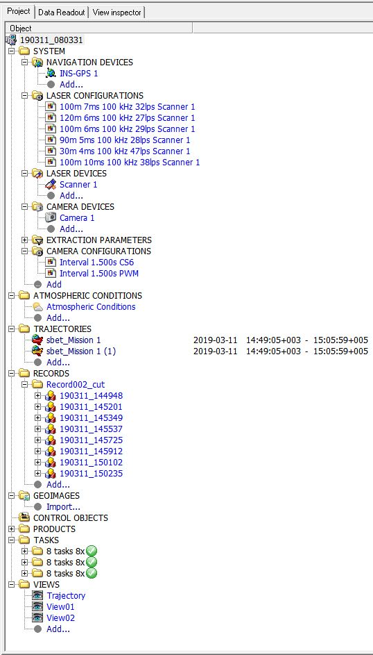
LiDAR data processing
Due to permissions associated with Riegl software on the Floodwave Server it is recommended to copy the *.rpp RiProcess folder for the desired flight at this stage (before Step 5) to the temp folder on the local drive on SWSL1, SWSL2 and G1803000 machines. Process and export the data and copy back to the Floodwave processing folder.
Step 5: Data Processing wizard
Right click on Records and choose Data Processing Wizard.
Task selection <next>
Input and Selection - Highlight Lidar files <next>
Schedule and Output - ** Check Output Directory <next>
Task Creation <OK>
Progress will appear in the “TASKS and SERVERS” tab -bottom
Step 6: RiPrecision
Highlight the Records entry in the left hand window
Choose RiPrecision from the TOOLS menu
Objects window opens – Highlight the Trajectory and Scanner <next>
Features window opens – add GNSS pts > need to import control point object <next>
Summary Window opens - <OK>
Progress is visible in the lower window. In the “TASKS and SCANNERS”. Calculation Settings > when finished save and show report.
Records > right click > export laser data > combine data > coord system 11 N WGS84/ UTM zn 11 N
All Tasks need the green checkmark - just wait.
RiPrecision report will show up to provide statistics.
<number>

Slide 18
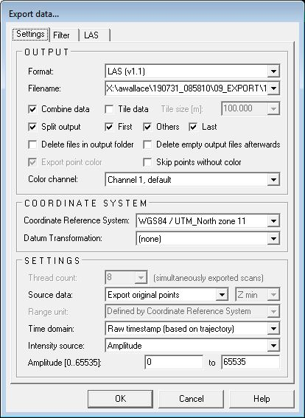
LiDAR data processing
Step 7: Data Export
Right click on Records and choose Export – 3 options:
Laser Data / Camera Data / Trajectory Data
The Export Data window appears
Choose format
Check output directory location
Combine data – 1 large file of all strips
Split output splits files into separate files
Make sure coordinate system is correct
Progress appears in the “TASKS and SERVERS” bottom window.
Step 8: Viewing outputs
To view data scroll to bottom of left hand window Under VIEWS choose ADD.
Window opens on how to view (i.e by height) – ok
Drag and drop the records into the viewing window. All at once or individually
The Measure and Profile tools utilize the “ALT” button and left mouse button
<number>

